Slide 1


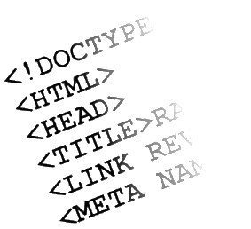

Web Design and UI Technologies
Track Overview
Svetlin Nakov
Manager Technical Training
www.nakov.com
Telerik Software Academy
academy.telerik.com

Slide 2


Table of Contents
"Software Academy" Program – reminder
Track Objectives & Program
Assessment
Learning Resources

Slide 3



"Software Academy" Program
Quick Reminder

Slide 4
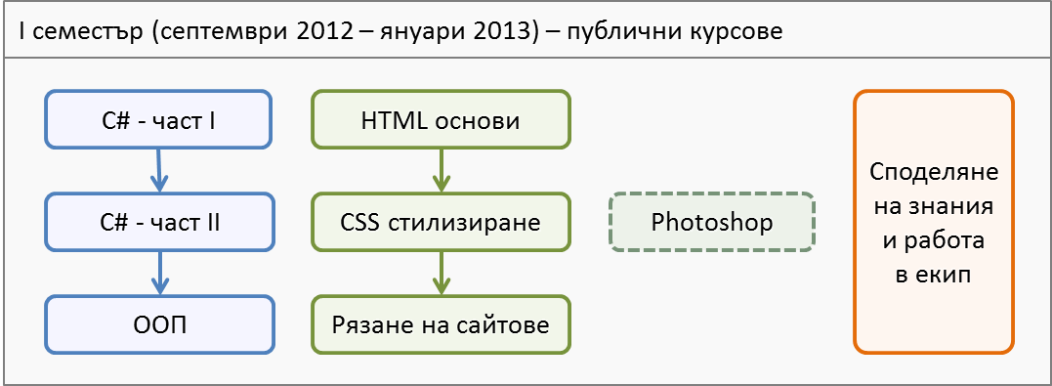
Software Academy: First Semester
The 1st semester
C# programming and Web technologies basics
3-4 times weekly, 4 hours in class + homework

Slide 5
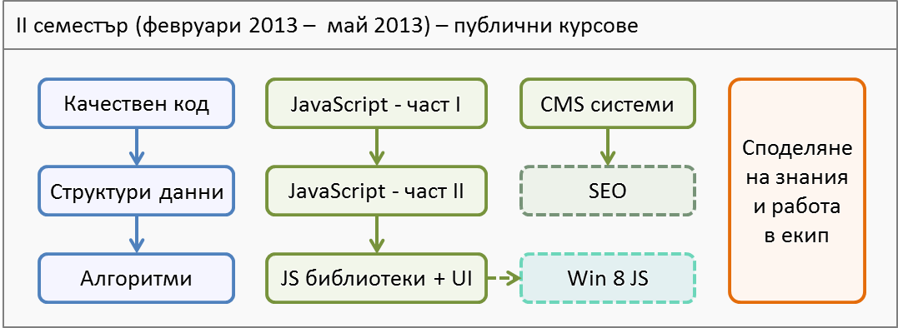
Software Academy: Second Semester
The 2nd semester
Advanced C# and JavaScript programming
3-4 times weekly, 4 hours in class + homework

Slide 6
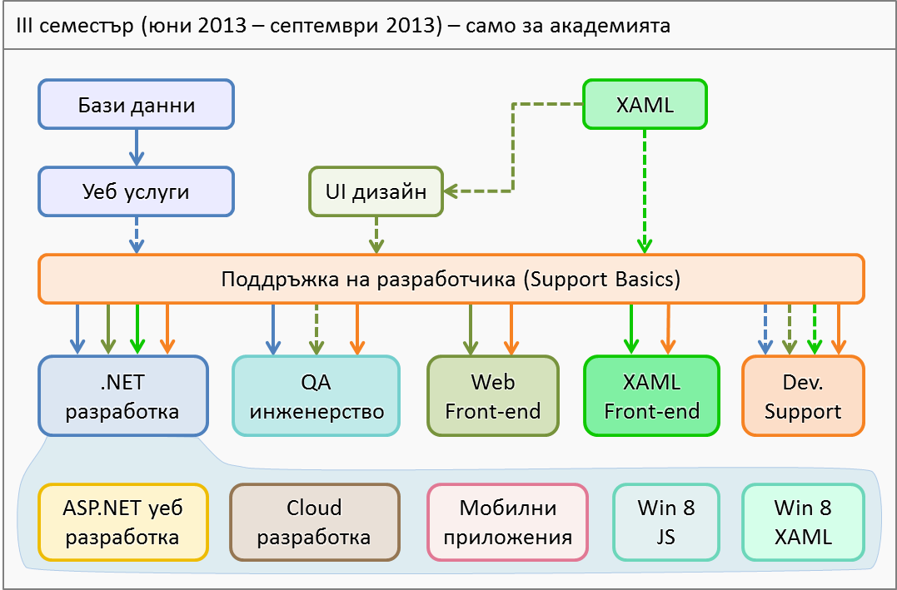
Software Academy: Third Semester
Full time – 5 times weekly, 8 hours in class

Slide 7

Web Design and UI Technologies: Objectives & Program
What Topics Shall We Cover?

Slide 8
About the Track
Web Design and UI Technologies track objectives
Provide concepts, technologies and skills for web front-end development
HTML 5, CSS 3 and JavaScript
Basics of SEO and CMS (WordPress, Sitefinity, Joomla)
Teach the basics of creating user interface
Cover technologies for building desktop UI
In the later stages of the track

Slide 9

Track Curriculum

Slide 10
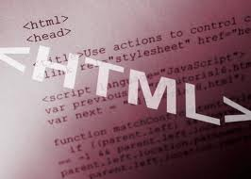
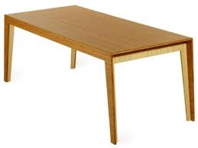

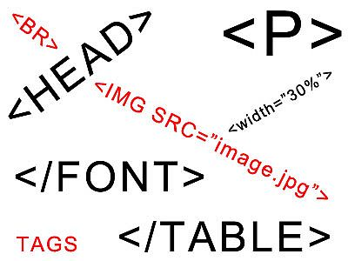

HTML Basics
Web Design Concepts and Tools
Introduction to HTML
HTML Tables
HTML Forms
Semantic HTML
Test Preparation
HTML Basics Test

Slide 11
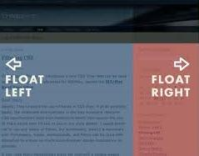
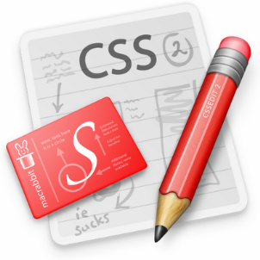

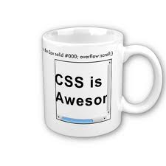

CSS Styling
CSS Basics
CSS Presentation
CSS Positioning
CSS 3
Exam Preparation
CSS Styling Exam
Parallel course
Photoshop

Slide 12



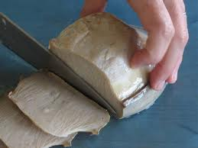
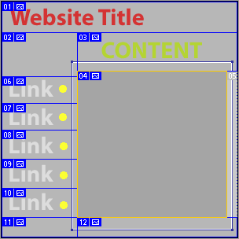


Slice and Dice
Creating websites with HTML and CSS
Workshop – Slice & Dice
Slice & Dice Exam

Slide 13




JavaScript Basics
Intro to JavaScript development
Data Types and Variables
Operators and Expressions
Conditional Statements
JavaScript Practical Exam
Parallel course
Content Management Systems (CMS)

Slide 14
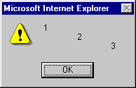
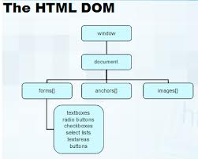

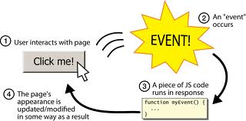
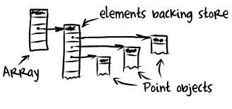

Advanced JavaScript
Loops
Arrays
Functions
Using Objects
DOM Manipulation
JavaScript OOP
JavaScript Events
JavaScript APIs
Exam Preparation
JavaScript Practical Exam
Parallel course – Search Engine Optimization

Slide 15




JavaScript Libraries and UI
JavaScript Libraries
jQuery
Asynchronous JavaScript and XML
Web Services and REST
Consuming RESTful web services
Working with External JavaScript APIs
JavaScript UI Frameworks
Best Practices
Exam Preparation
JavaScript Practical Exam

Slide 16


Assessment
Exams and Grades

Slide 17

Scoring for HTML Basics
Attendance – 10%
Test – 65%
Serves as primary pass / fail criteria for the course
Homework – 25%
Forums activity – bonus up to 10%
PC Magazine & Telerik Contest – bonus up to 10%
Helping the other students – bonus up to 10%
Knowledge sharing / blogging – bonus up to 20%

Slide 18
Pass / Fail / Excellence Criteria
HTML Basics – pass / fail / excellence criteria:
Test
Very low results → fail (course not taken)
Average results → pass (course taken)
High results + Homework → pass with excellence
Homework
Good results required to pass with excellence

Slide 19
HTML Basics Test – Sample Question
You are given the following (exact) HTML code:
<div>
<p>This is\r\n
multi-line
text</p>
</div>
What will the page text look like in a modern browser?
This is multi-line text
404 – not found
This is multi-line text
This is\r\n multi-line text

Slide 20
For HTML5 Course Attendees
You have already attended the HTML5 course at Telerik Academy
You have defended a practical project
Shall you attend the HTML Part 1 course?
You need to:
Submit the homework assignments
Come to take the final test
You don’t need to:
Visit the lectures (the system will count you in)

Slide 21
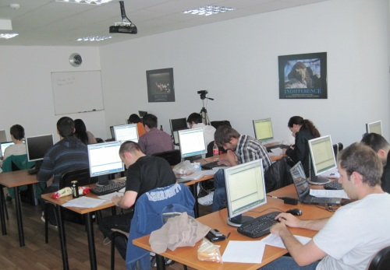
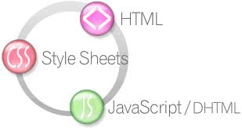
HTML Basics Course – More Details
Duration, Languages, Technologies

Slide 22


Training Duration – HTML Basics
Lectures: ~ 12 hours
Practical exercises: optional, ~12 hours
Homework: ~ 20-30 hours
Test: 1 hour

Slide 23
Why HTML, CSS and JS?
HTML, CSS and JS – standard for web-based UI
Web-based applications are extremely popular
Run on anything with a browser
Windows 8 devices can run HTML, CSS and JS natively
HTML and CSS – evolving standards
JavaScript
High-level scripting language, fast to write, object-oriented, runs on client, lots of APIs

Slide 24

Recommended Books

Slide 25



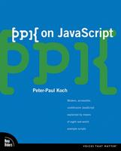
Recommended Books
“Designing with Web Standards”, Jeffrey Zeldman, New Riders Press, 2005, ISBN 9780321616951
"HTML & XHTML: The Definitive Guide, Sixth Edition", Chuck Musciano, Bill Kennedy, O'Reilly, 2006, ISBN 9780596527327
"CSS: The Definitive Guide, Third Edition", Eric Meyer, O'Reilly, 2006, ISBN 9780596527334
“PPK on JavaScript”, Peter Paul-Koch, New Riders Press, 2006, ISBN 9780321423306

Slide 26
Web Design and UI Technologies
http://academy.telerik.com

Slide 27


Free Trainings @ Telerik Academy
"Web Design with HTML5, CSS3 and JavaScript" course @ Telerik Academy
html5course.telerik.com
Telerik Software Academy
academy.telerik.com
Telerik Academy @ Facebook
facebook.com/TelerikAcademy
Telerik Software Academy Forums
forums.academy.telerik.com

